Slide 1
Computer ‘Vision’ {
Computer Vision.py
workshop.css
[For Beginners Workshop]
cv2.video()
}
Programming Language

Slide 2
Computer Vison {Introduction}
What is Computer vison? .py
workshop.css
Computer Vision is a field of artificial intelligence (AI) that enables computers and systems to derive meaningful information from digital images, videos, and other visual inputs—and take actions or make recommendations based on that information.
Essentially, it seeks to replicate the complexity of human vision using software and hardware.
This involves the acquisition, analysis, processing, and understanding of visual data, and the ability to act on it.
}
Programming Language

Slide 3

How does Computer understand Images{
Vison Working.py
workshop.css
What‘s an Image?
< 2D projection of a 3D scene
What’s a Video?
<multiple images presentes in a continous time interval
Camera captures images
Programming Language

Slide 4
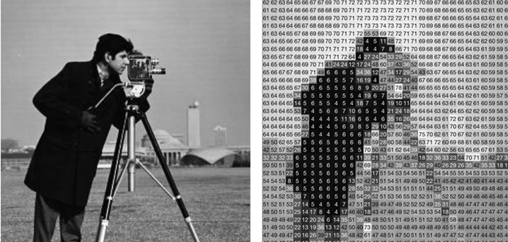
Image.html
workshop.css
pixel
< Pixel aka picture element (pix = picture, el = element) is the atomic element of an image >
Programming Language

Slide 5
Handson.py
# Handson 101
print(“Lets get our hands dirty”)
Programming Language

Slide 6
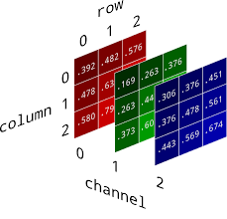
forbeginners.html
workshop.css
Programming Language

Slide 7
Learn the basics of Open CV
forbeginners.html
workshop.css
Programming Language

Slide 8
Project 1 {color object tracker} def tracker(): if color==‘red’: begin tracking()
forbeginners.html
workshop.css
Programming Language

Slide 9
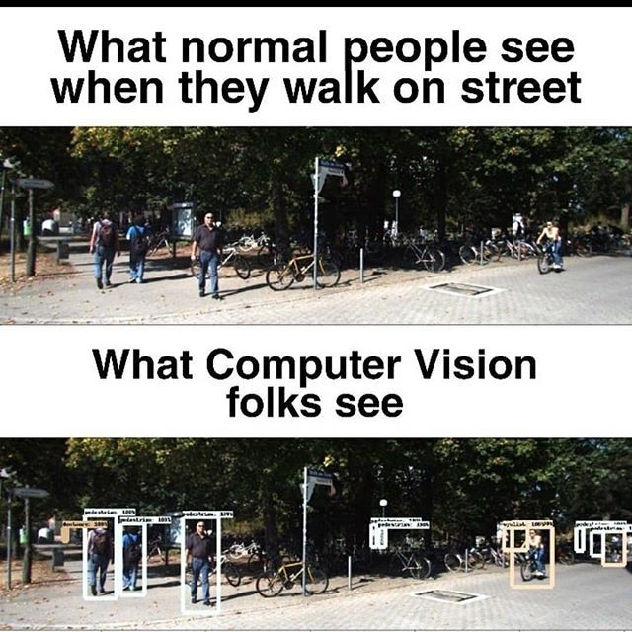
End of session 2 {Ask doubts if any}
forbeginners.html
workshop.css
Programming Language

Slide 10
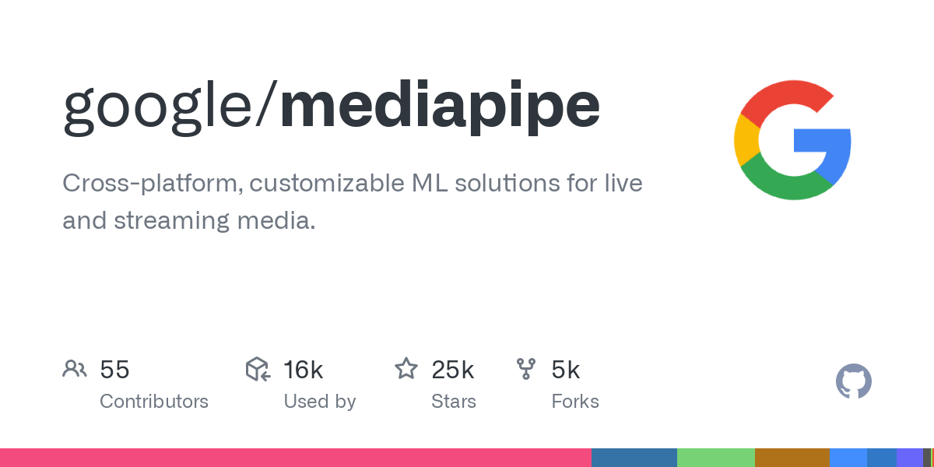
Mediapipe {Warning: This session may cause extreme coding excitement}
forbeginners.html
workshop.css
Programming Language

Slide 11
Mediapipe{byGoogleforDevs}
What_is_mediapipe.ipynb
workshop.css
Framework
< building and deploying on-device machine learning solutions.
pre-built solutions
< common machine learning and Dl tasks.
EasyIntergration
< easily integrated into your applications using the MediaPipe API.
Customizable
< can be customized using MediaPipe Model Maker.
LoW code/no code framework
Programming Language

Slide 12
Get started{Lets Explore!!}
features.ipynb
workshop.css
Programming Language

Slide 13
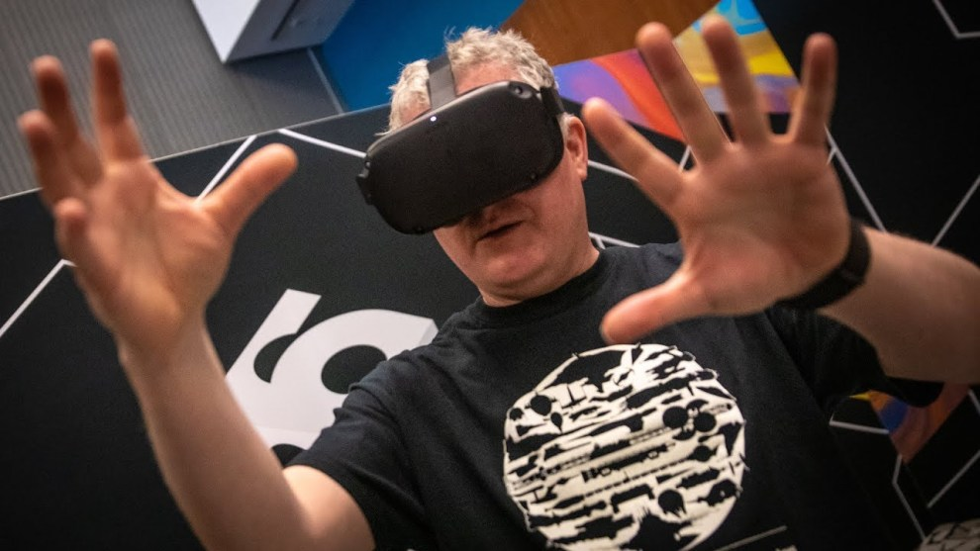
Project 2{Hand tracking mouse}
Handson.Ipynb
workshop.css
Programming Language

Slide 14
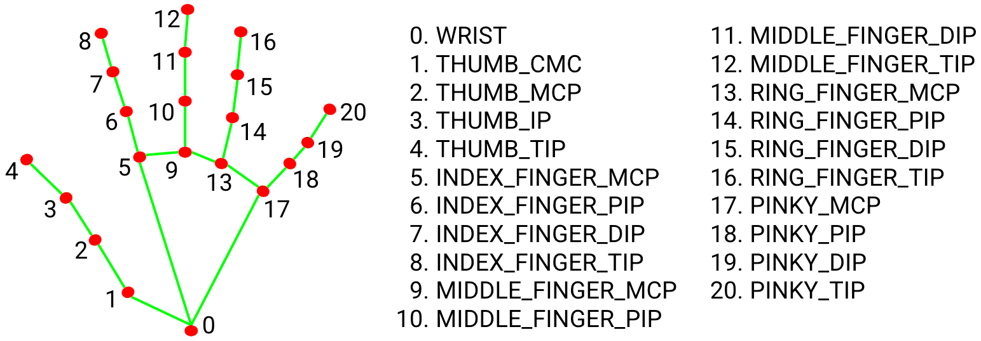
forbeginners.html
workshop.css
Programming Language

Slide 15
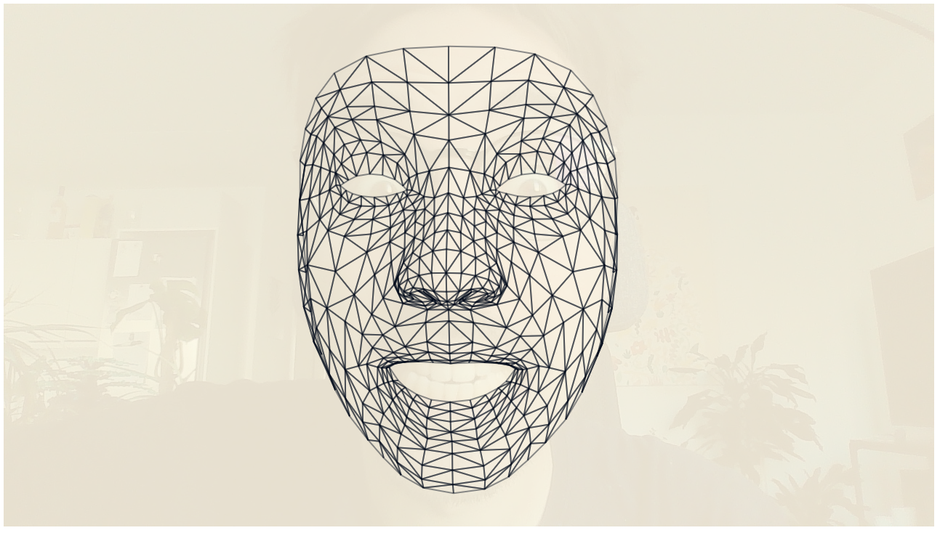
Project 3{head tracking mouse}
Handson.Ipynb
workshop.css
Programming Language

Slide 16
If Doubts==True
Ask_doubts()
Else:
Start_recap()

Slide 17
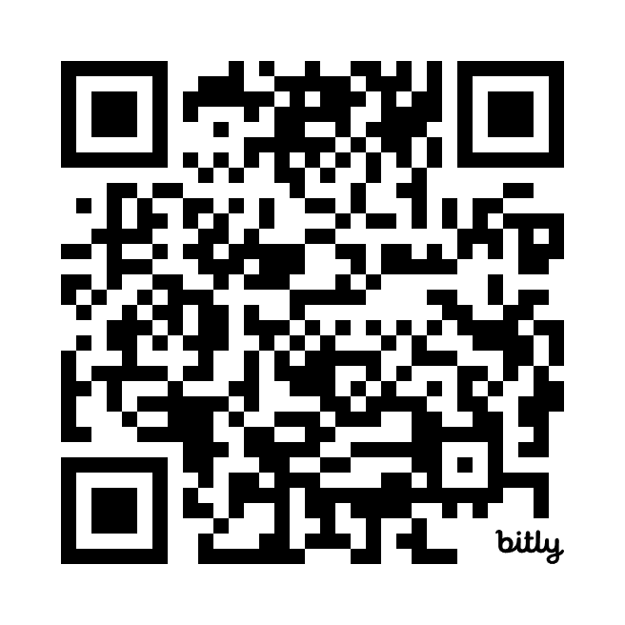

Slide 18
End of Session

